Slide 1
VQA, and why it’s asking the wrong question
Anton van den Hengel,
The Australian Centre for Visual Technologies, Director
The University of Adelaide, Professor
Notes:
The two most interesting things about recent methods for Visual Question Answering are how clever they are, and how daft they are. These methods have made amazing progress on a task that tests general, high-level image understanding, and have demonstrated results that would have been thought impossible only a few years ago. They seem to have done so without actually achieving general, high-level image understanding, however. This talk will discuss some possible steps towards truly general high-level image understanding, how difficult it is, and some of the resources we might leverage

Slide 2
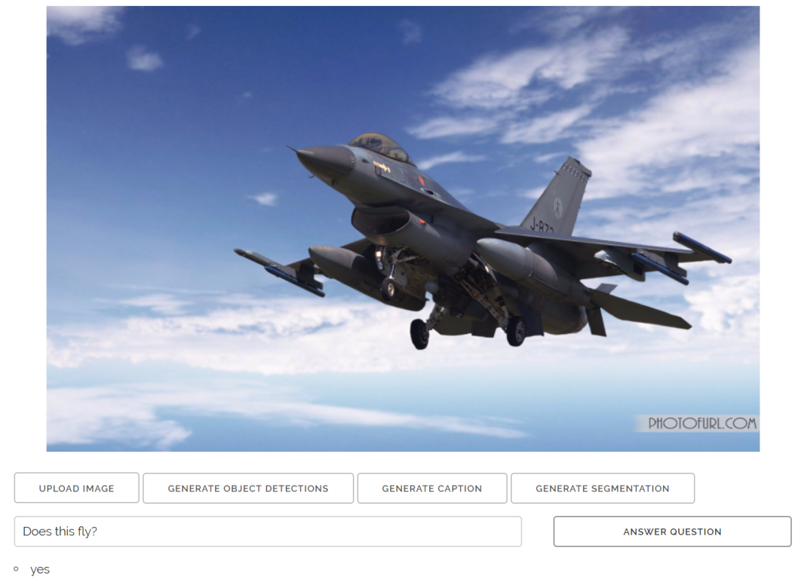
VQA is a fantastic challenge
Notes:
It has pushed the field in really interesting directions
For a long time you couldn’t ask AI questions in CV papers
An overreaction to the AI winter

Slide 3
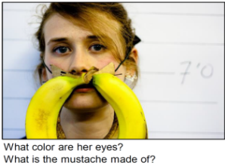
The methods really are good
Notes:
It is answering questions we thought would be years away
Generality / diversity of questions
Generality of expression
Loose relationship between training data and test questions
Generalisation is the key to human intelligence
It’s a step towards AI
It’s an excuse to think about AI in CV

Slide 4
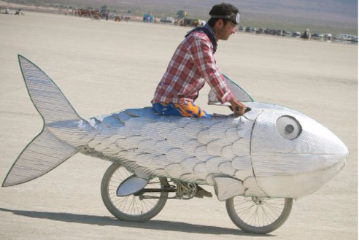
Q: Is this a fish or a bicycle?
A: No

Slide 5
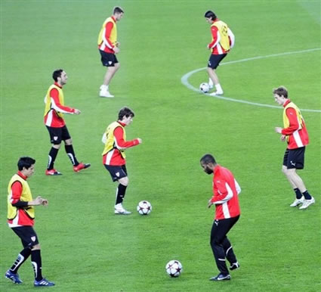
Q: What game are they playing
A: Soccer

Slide 6
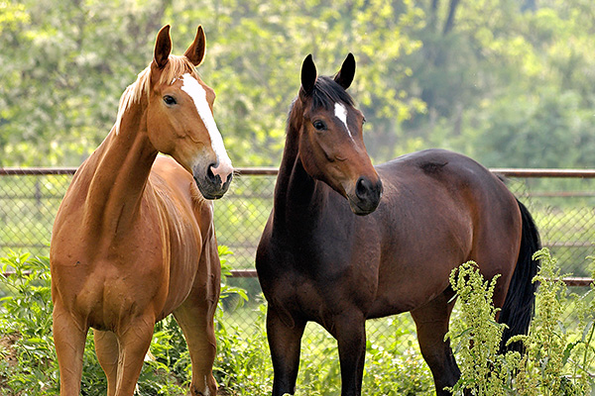
Counting is a complicated idea
Q: How many horses are in the image?
A: 2

Slide 7
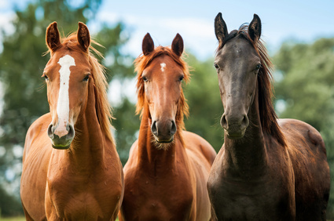
Counting is harder than it looks
Counting is harder than it looks
Q: How many horses are in the image?
A1: 2
A2: 3

Slide 8
Counting is a complicated idea
Q: How many unicorns are in the image?
A: 2

Slide 9
Q: How many unicorns are in the image?
A: 2

Slide 10
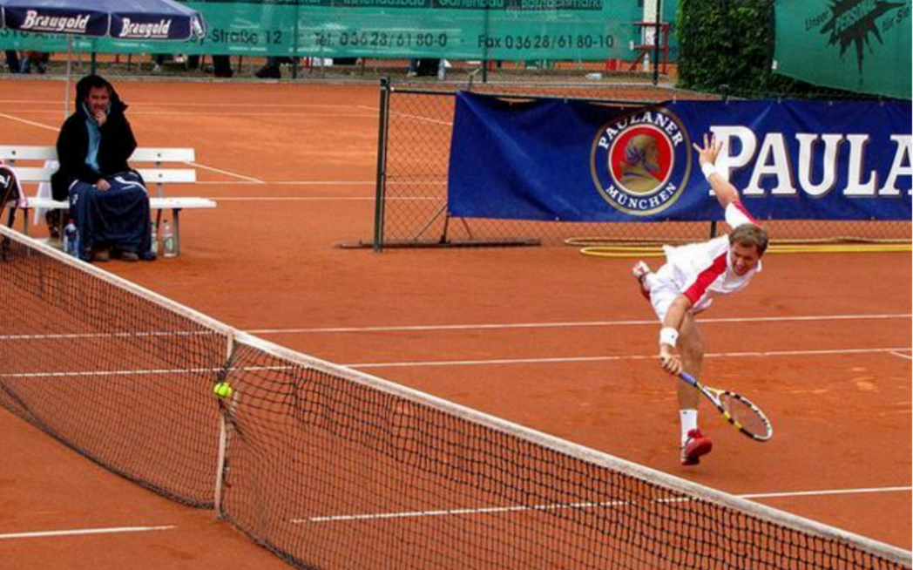
Did this player win the point?
yes
tennis court
Image and VQA: http://visualqa.csail.mit.edu/

Slide 11
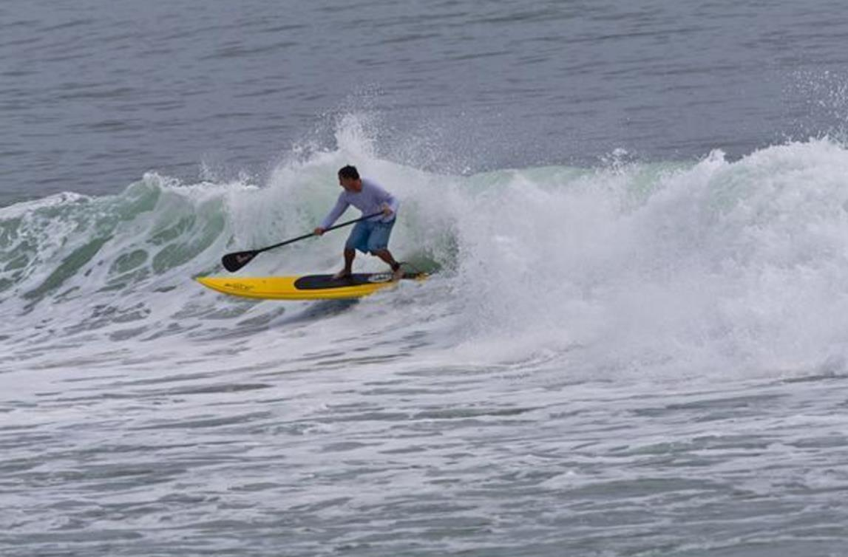
Where was this photo taken?
No
Yes
Lake
Image and VQA: http://visualqa.csail.mit.edu/

Slide 12
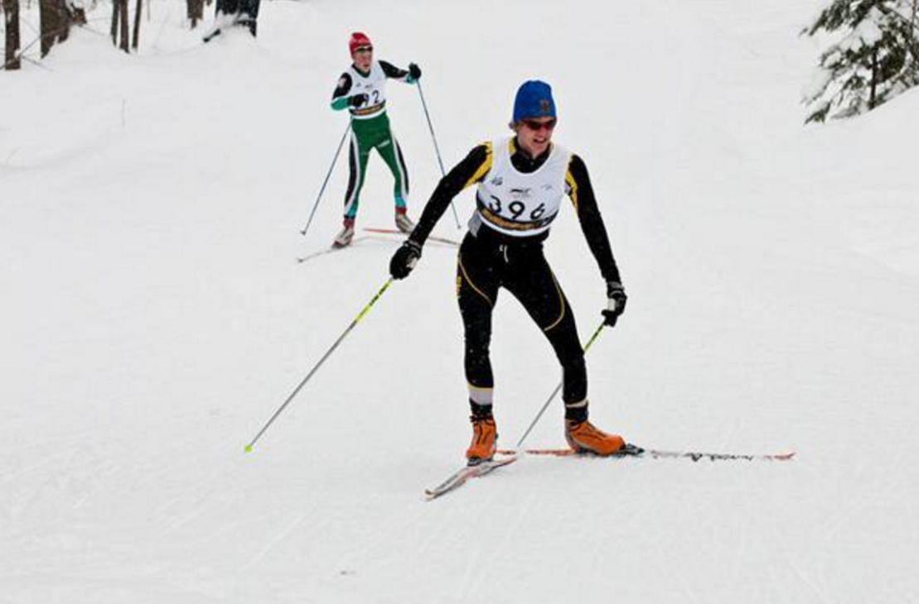
Who’s winning?
Yes
No
Skiing
Image: http://visualqa.csail.mit.edu/

Slide 13
NLP QA tackles harder questions
TREC questions:
What was the monetary value of the Nobel Peace Prize in 1989?
What does the Peugeot company manufacture?
How much did Mercury spend on advertising in 1993?
What is the name of the managing director of Apricot Computer?
Why did David Koresh ask the FBI for a word processor?
From a large set of documents
Still closed world
Average performance is about 70%

Slide 14
NLP QA tackles harder questions
Watson won Jeopardy
Q: William Wilkinson’s “An Account of the Principalities of Wallachia and Moldovia” inspired this author’s most famous novel
A: Bram Stoker

Slide 15
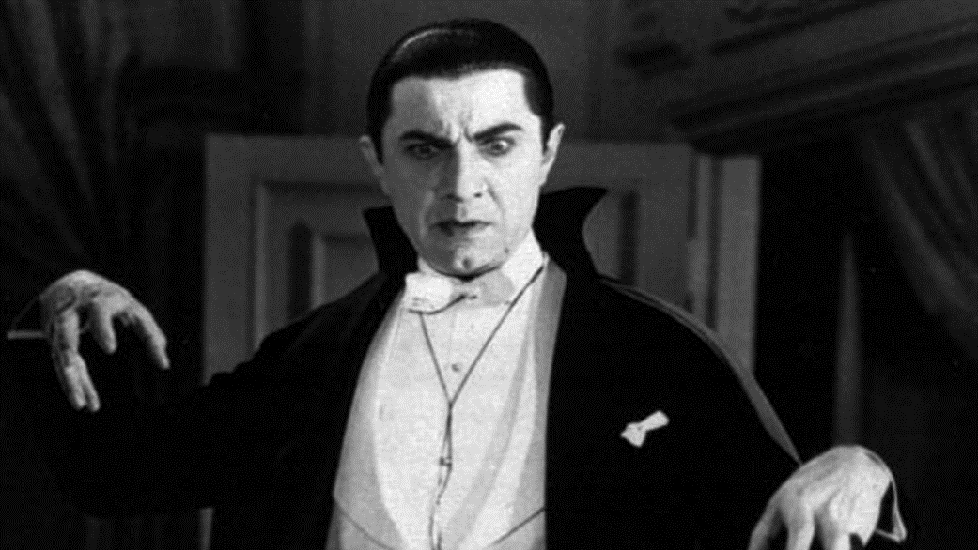
Who wrote a book about this guy?
michael
bill
queen
big
baby

Slide 16
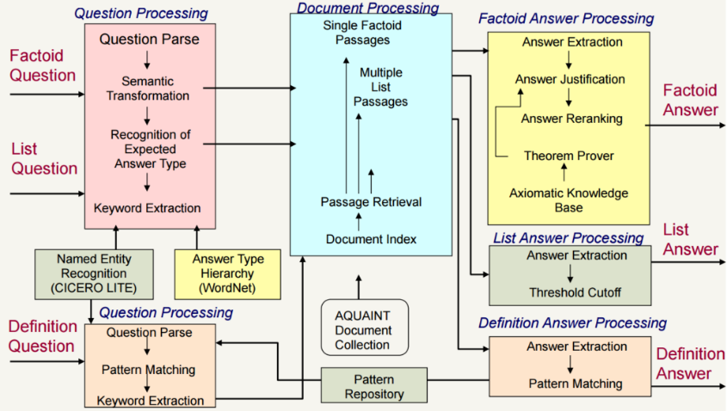
NLP QA is complex

Slide 17
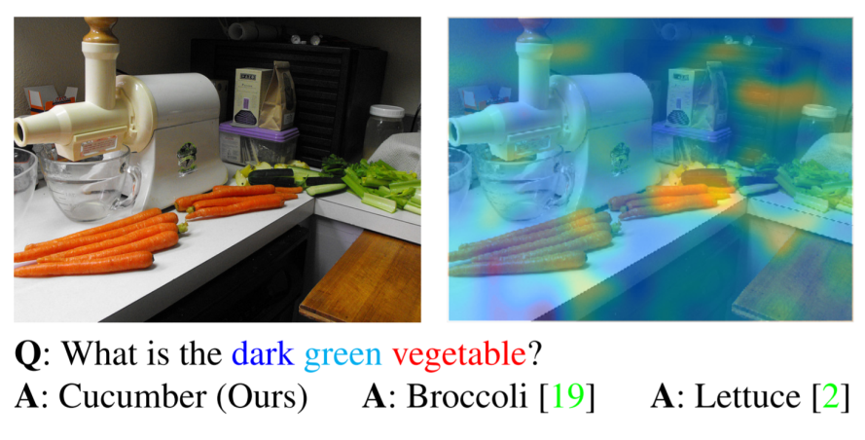
How much can an RNN remember?

Slide 18
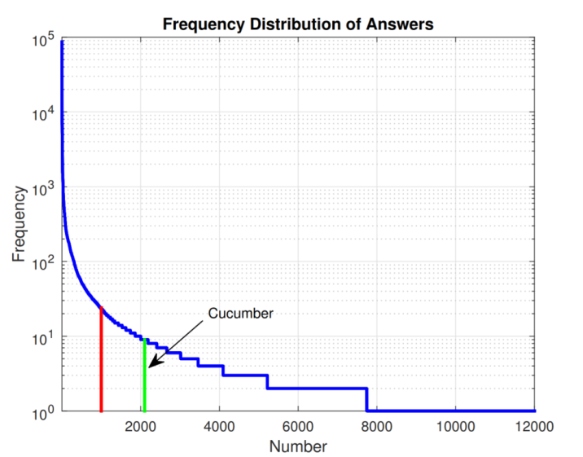
We’re not covering the training data

Slide 19
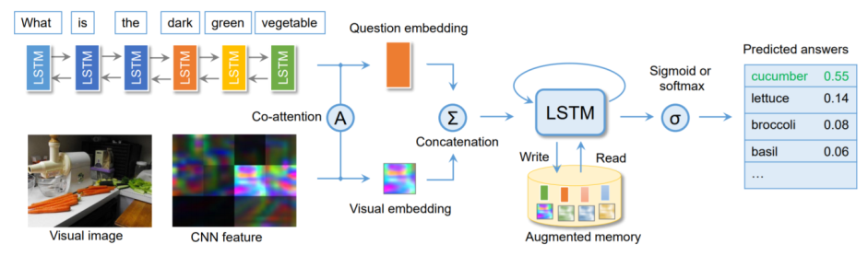
Covering all of the training data
Visual Question Answering with Memory-Augmented Networks
Chao Ma, Chunhua Shen, Anthony Dick, Anton van den Hengel
http://arxiv.org/abs/1707.04968

Slide 20
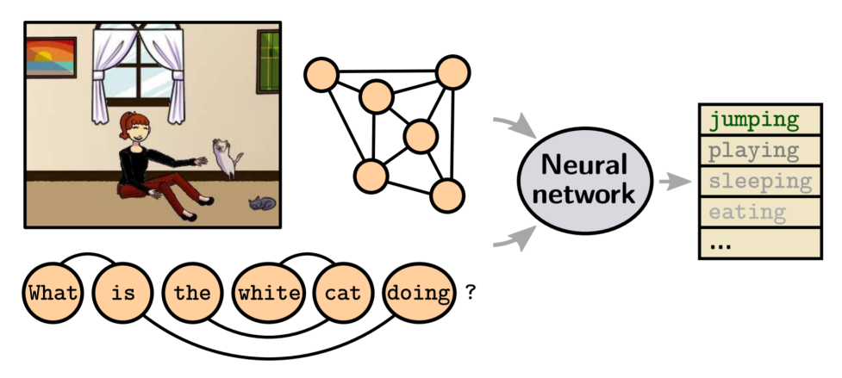
Reasoning (over graphs)

Slide 21
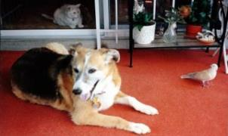
Visual info is not enough
Q: How many mammals are there in this image?
Notes:
For example, to answer the question that ‘how many mammals in the image’, given an photo which contains dog, cat and bird, we need the common sense knowledge that dog and cat are mammals but bird is not.
Another example is shown on the lower right and the question is ‘why are they wearing such bright colour?’. The external source knowledge required here is that bright colour jacket can be used for safety reasons..

Slide 22
Bringing in other information
Critical if the process is to be general
It’s not feasible to train an RNN to usefully encode all of the knowledge required to answer general questions
But once you have another source of information, what can you do with it?
This is the really interesting question!

Slide 23
Google it?
Can we go to the web to get relevant information?
It’s what humans do
Take the top 5 attributes and search
Actually we search Wikipedia, not the whole net
That gives us text which relates to the image content

Slide 24
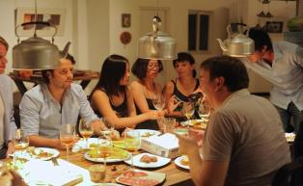
Wikipedia and Visual Question Answering
Image
Extract Image Features
CNN
Attribute/Label/
Location Predictions
Wikipedia
Q: What kind of glasses are they drinking out of ?
Language Modeling
LSTM
A: Wine
What Value Do Explicit High Level Concepts Have in Vision to Language Problems? Qi Wu, Chunhua Shen, Lingqiao Liu, Anthony Dick, and Anton van den Hengel, CVPR’16

Slide 25
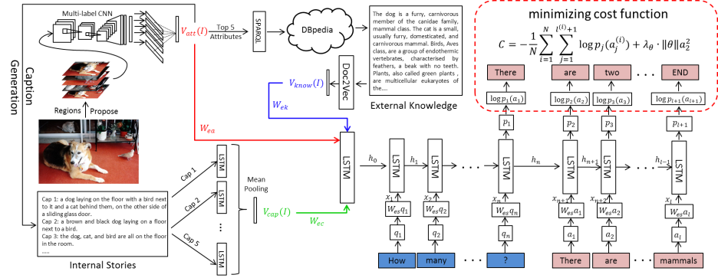
Merging image and web information

Slide 26
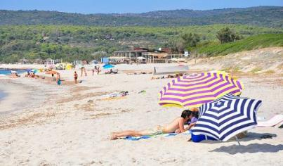
Example
Attributes:
umbrella
beach
sunny
day
people
sand
laying
blue
… …
Caption:
A group of people enjoying a sunny day at the beach with umbrellas in the sand.
External Knowledge:
An umbrella is a canopy designed to protect against rain or sunlight. Larger umbrellas are often used as points of shade on a sunny beach. A beach is a landform along the coast of an ocean. It usually consists of loose particles, such as sand….
Question Answering:
Q: Why do they have umbrellas? A : Shade.
Notes:
There is a real example produced by our ACK system.
Given a such image, multiple attributes are first detected and further produce an internal textual representation. External Knowledge are mined from the Knowledge Base via the top-5 detected attributes as queries. All these information are encoded as vector representations. Given a question ‘why do they have umbrellas’, we give the word ‘shade’ as the answer.
A key common sense knowledge reasons to the answer here is that ‘Larger umbrellas are often used as points of shade on a sunny beach.’

Slide 27
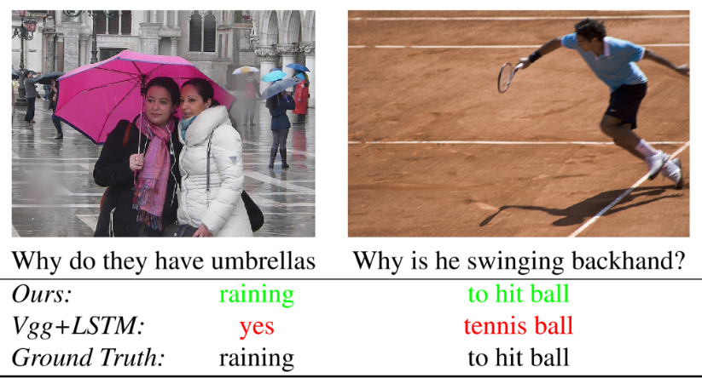

Slide 28
Explicit reasoning
Separate the language from the reasoning
Answers are much easier to believe if there’s a reason given
Explicit storage means less to store implicitly
It’s not feasible to store common sense implicitly
And why train a NN to do something it’s not good at
c.f. Neural Turing Machines

Slide 29
Use a Knowledge Base
Scraped or hand crafted
RDF tuples
<Obama, President, United States of America>
But not <everything, gravity, everything>
In a DBMS
Which does inference
Admits queries in SPARQL (which is like SQL)

Slide 30
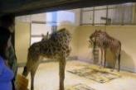
Reasoning in VQA
Visual Concepts
Input Image
Object: Person, Giraffe
Attributes: glass, house, room,
standing, walking, wall, zoo
Scenes: museum, indoor
DCNN
models
Input Question
What are the common properties between the animal in this image and the zebra?
QUEPY
Linked
Knowledge
Graph
Visual Concepts
DBpedia Concepts
Obj-4
name
same-
concept
KB:Human
Database Queries
Img
contain
ObjCat
-person
subject
contain
KB:Giraffe
KB:Cat-
Megafauna
of Africa
?x:((KB:Giraffe, subject/?broader, ?x) AND
(KB:Zebra, subject/?broader, ?x))
contain
Obj-3
name
bbox
subject
Obj-1
{x,y,w,h}
same-
concept
KB:Cat-
Herbivorous
animals
subject
color
name
subject
Brown
KB:Zebra
Answer and Reason
color
ObjCat
-giraffe
broader
contain
Obj-2
name
KB:Cat
-Animals
broader
KB:Cat
-Zoology
A: Herbivorous animals, Animals, Magafauna of Africa
R:
img-att
name
AttCat
-zoo
same-
concept
Giraffe
Herbivorous animals
animals
Att-1
KB:Zoo
subject
Zebra
Magafauna of Africa

Slide 31
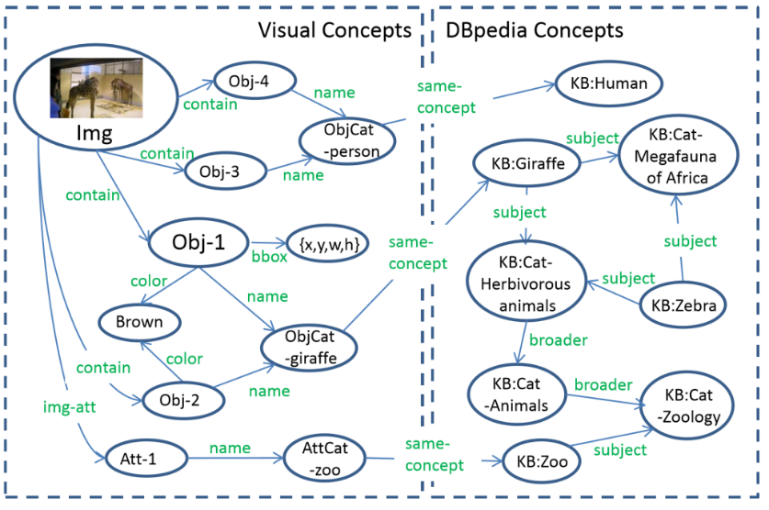
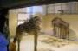
Visual Concepts
DBpedia Concepts
Obj-4
name
same-
concept
KB:Human
contain
Img
ObjCat
-person
subject
KB:Cat-
Megafauna
of Africa
contain
KB:Giraffe
Obj-3
name
contain
subject
Obj-1
{x,y,w,h}
same-
concept
subject
bbox
KB:Cat-
Herbivorous
animals
color
subject
name
KB:Zebra
Brown
ObjCat
-giraffe
broader
contain
color
name
KB:Cat
-Animals
broader
KB:Cat
-Zoology
img-att
Obj-2
name
AttCat
-zoo
same-
concept
subject
Att-1
KB:Zoo

Slide 32
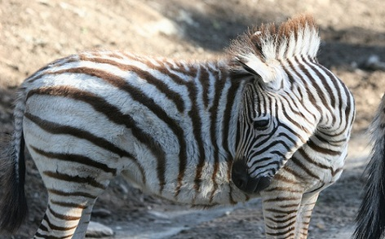
Traversing the Knowledge Base
Q: List close relatives of the animal.
A: Donkey, horse, mule, asinus, hinny

Slide 33
We’re good at Vision already
You can’t train an RNN to do all of Vision from QA examples
And we’ve already solved a lot of Vision problems
So learn to use existing algorithms
C.f. the Neural Turing Machine

Slide 34
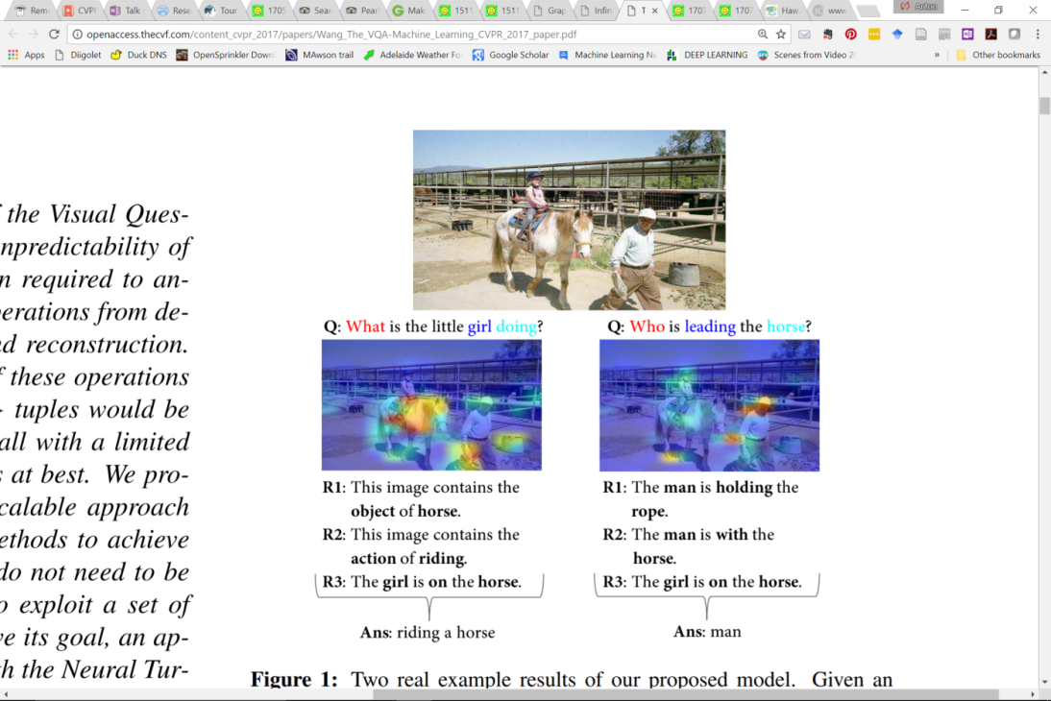
The VQA-Machine

Slide 35
The VQA-Machine

Slide 36
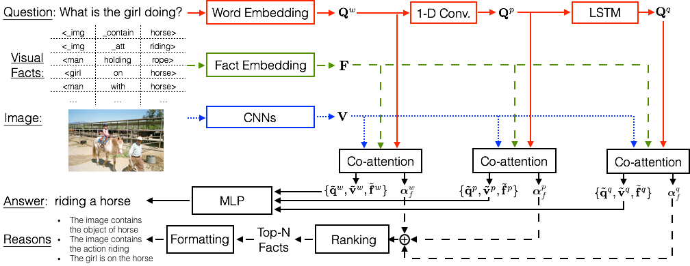
The VQA-Machine

Slide 37
VQA has been great
It’s a great excuse to take real steps towards hard AI
VQA2.0 is an important step
Helps isolate the language prior
But we need to move on to harder questions
Part of the problem is that the current questions have no purpose
The Turker doesn’t care about the answer
This underlies the evaluation problem
The NLP community have some good ideas

Slide 38

